Slide 1
Training Name
By Amit M

Slide 2
Trainer Profile
Trainer Experience in IT: Overall 17 years of experience
Experience in the current training topic: git,Jenkins,cicd,docker Kubernetes,service mesh,argocd,terraform,jfrog,gke
Production Experience if any:12 years of industry experience
Objective of this course :Cover Jenkins CI, and understand the cicd pipeline
Deliverable for the trainees:

Slide 3
Training Agenda Day wise
Day – 1
Jenkins Overview
Architecture
Jenkins setup
Master and Agent node explanation
Jenkins dashboard option
Plugins overview
Write freestyle project
Git overview
Basic git commands
Git
Day – 2

Slide 4
Training Agenda Day wise
Day – 2
Jenkins build pipeline: overview and basic usage
Jenkinsfile: syntax, basic usage, and best practices
Jenkins build environment
Jenkins build trigger
Jenkins build job
Jenkins pipeline type
Groovy overview
Day – 3
Jenkins build reports
Jenkins notification
Jenkins authentication and authorization
Jenkins backup and restore

Slide 5
Training Agenda Day wise
Day – 4
Jenkins CLI
Rest api
Jenkins integration with SonarQube, it
Git webhook creation and auto-trigger pipeline
Jenkins best practice
Jenkins maven build
Jenkins docker build

Slide 6
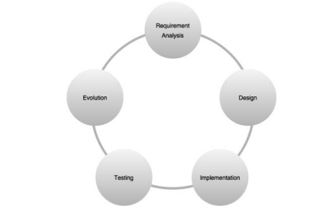
Software development life cycle
Software development life cycle, also referred as SDLC is the process of planning, developing, testing and deploying software
Teams follow a sequence of phases and each phase uses the outcome of the previous phase

Slide 7
Continuous Integration (CI)
Software development process mainly focuses on faster delivery
Continuous Integration helps it in achieving that speed How?
Developing a feature may involve a lot of code changes, and between every code change, there can be a number of tasks, such as checking in the code, polling the version control system for changes, building the code, unit testing, integration, building on integrated code, packaging, and deployment.
In a Continuous Integration environment, all these steps are made fast and error-free using automation
Don't check-in when the build is broken
Automate the deployment

Slide 8
How to achieve Continuous Integration
Implementing Continuous Integration involves using various DevOps tools.
All the following mentioned tasks fall under development operations:
Build and release management
Deployment management
Version control system administration
Software configuration management
All sorts of automation
Implementing continuous integration
Implementing continuous testing
Implementing continuous delivery
Implementing continuous deployment
Cloud management and virtualization

Slide 9
Use a version control system
This is the most basic and the most important requirement to implement Continuous Integration. A version control system, or sometimes it's also called a revision control system, is a tool used to manage your code history.
It can be centralized or distributed.
Two of the famously centralized version control systems are SVN
and IBM Rational ClearCase.
In the distributed segment, we have tools such as Git
Version control is a system that record changes to a files or set of files over the time that you can recall specific version
It allows you to revert selected files back to a previous state , revert the entire project to a previous state

Slide 10
What is Git
Git is a version control system that you can download onto your computer
Git allow developer to collaborate with other developers on a coding project or work on your own project.
Git software has to install on your system
Check git --version

Slide 11
What is Github?
GitHub is a product that allows you to host your Git projects on a remote server somewhere (or in other words, in the cloud).
It's important to remember that GitHub is not Git. GitHub is just a hosting service. There are other companies who offer hosting services that do the same thing as GitHub, such as Bitbucket and GitLab.

Slide 12
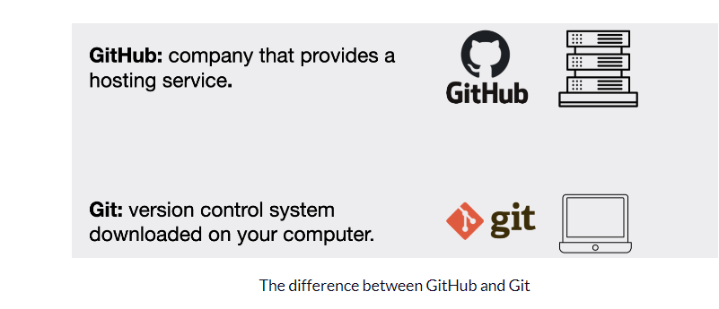
Git and Github

Slide 13
Overview
Git is a distributed version control system that allows multiple developers to work on the same project simultaneously.
It keeps track of all changes made to a file or a set of files, allowing you to easily roll back to a previous version if needed. Here are some basic terms of Gits
Repository
Commit
Push
Pull
Branch
Merge

Slide 14
How to Prepare your Project Folder in Git
To use Git we need to have a project that we want to version control. This can either be a new project or an existing project.
If it is a new project, then we need to create a new project folder (hint: we can use the mkdir command) and then navigate into that project folder in the terminal.
If we were to choose an existing project then we simply navigate into that project folder in the terminal.

Slide 15
Getting a Git repository
You typically obtain a Git repository in one of two ways:
You can take a local directory that is currently not under version control, and turn it into a Git repository, or
You can clone an existing Git repository from elsewhere.
In either case, you end up with a Git repository on your local machine, ready for work

Slide 16
Git init
If you have a project directory that is currently not under version control and you want to start controlling it with Git, you first need to go to that project’s directory.
for Linux:
$ cd /home/user/my_project
And type
git init
This creates a new subdirectory named .git that contains all of your necessary repository files — a Git repository skeleton. At this point nothing in project will be tracked

Slide 17
Git add and commit
If you want to start version-controlling for existing files , should begin tracking those files and do a initial commit.
“git add” commands that specify files you want to track, followed by “git commit”
Lab:
touch License
git add License
git commit –m “first commit”

Slide 18
Git add
This will put the file in tracking
File will be in stage area
We cannot directly add the file in commit, first file has to be in stage area
Remember that anything that is still unstaged — any files you have created or modified that you haven’t run git add on since you edited them — won’t go into this commit.

Slide 19
Git commit
In this case, let’s say that the last time you ran git status, you saw that everything was staged, so you’re ready to commit your changes. The simplest way to commit is to type git commit
git commit will add all the files in the latest snapshot.
All changes will go by default in the main branch
Removing files for git repos: To remove a file from Git, you have to remove it from your tracked files (more accurately, remove it from your staging area) and then commit. The git rm command does that, and also removes the file from your working directory so you don’t see it as an untracked file the next time around.

Slide 20
Jenkins Overview
Jenkins is an open source application written in Java. It is one of the most popular continuous integration (CI) tools used to build and test different kinds of projects.
Jenkins can be used to achieve Continuous Delivery, Continuous Testing, and Continuous Deployment.
Jenkins is supported by a large number of plugins that enhance its capability.
The Jenkins tool is written in Java and so are its plugins.
The tool has a minimalistic GUI that can be enhanced using specific plugins if required.

Slide 21
Jenkins History
It was originally developed as an extension of the Hudson project in 2011 and was subsequently renamed Jenkins due to trademark issues.
In 2004, Kohsuke Kawaguchi, a software developer at Sun Microsystems, created the Hudson project to provide an extensible continuous integration server.
In 2011, Oracle acquired Sun Microsystems and subsequently trademarked the name "Hudson."
The Hudson community decided to continue development under a new name, Jenkins, which was first released in February 2011.
In 2019, the Jenkins project joined the Continuous Delivery Foundation, a vendor-neutral organization that aims to promote the practice of continuous delivery.

Slide 22
Jenkins components
Jenkins Master The Jenkins master is the central component of the Jenkins architecture. It is responsible for managing the overall build and deployment process. It handles user requests, scheduling and running builds, and communicating with other components.
Jenkins Agents (or Slaves) Jenkins agents, also known as slaves, are responsible for executing build jobs. They connect to the Jenkins master over the network and receive instructions on what to build and how to build it. The agents can be located on the same machine as the Jenkins master or on remote machines.
Jenkins Build Jobs Jenkins build jobs are the tasks that run on the agents to build, test, and deploy software. Build jobs can be created and configured using Jenkins' graphical user interface or by writing scripts in a Jenkinsfile

Slide 23
..
Jenkins Plugins Jenkins plugins are add-ons that provide additional functionality to Jenkins. They can be used to integrate Jenkins with other tools and services, add build steps to the build job, or provide reporting and analysis capabilities.
Jenkins Workspace The Jenkins workspace is the working directory where the build job is executed. It contains the source code, build scripts, and other files needed for the build process.
Jenkins Build Queue The build queue is a list of build jobs waiting to be executed. When an agent becomes available, it takes the next job from the queue and starts executing it.
Jenkins Artifacts Jenkins artifacts are the output files generated by the build job. They can include compiled code, documentation, test results, and other files needed for deployment
Jenkins Notifications Jenkins provides notifications to keep users informed about the status of builds and deployments. Notifications can be sent by email, text message, or other means, and can be configured to include information about build failures, successes, and other events.

Slide 24
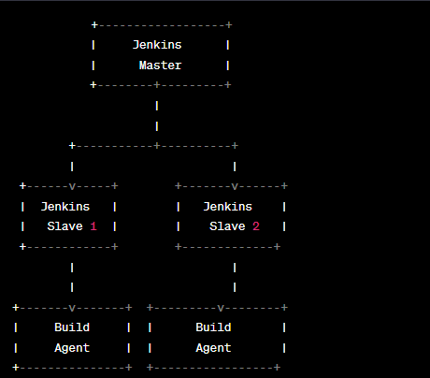
Jenkins Master-Slave Architecture

Slide 25
..
In this architecture, the Jenkins master is connected to multiple Jenkins slaves (also known as agents). The master is responsible for managing the build and deployment process, and it communicates with the slaves to delegate tasks and receive build results.
The slaves are responsible for executing the build jobs assigned to them by the master. They can be located on the same machine as the master or on remote machines. Each slave runs a Jenkins agent that communicates with the master to receive build instructions and report build results.
The build agents are responsible for executing the build steps, such as compiling code, running tests, and generating artifacts. They have access to the source code and build scripts, which are stored in the workspace

Slide 26
Jenkins Master node hardware requirement
Recommended hardware specifications for a Jenkins master node:
CPU: 2 GHz or faster, dual-core or higher
RAM: 4 GB or more
Disk Space: At least 50 GB of free disk space
Operating System: Jenkins can run on various operating systems, including Windows, Linux, and macOS.
In this training we will be using ubuntu 22.04 server edition.

Slide 27
Installation of Jenkins on Ubuntu22.04
curl -fsSL https://pkg.jenkins.io/debian-stable/jenkins.io-2023.key | sudo tee /usr/share/keyrings/jenkins-keyring.asc > /dev/null
echo deb [signed-by=/usr/share/keyrings/jenkins-keyring.asc] https://pkg.jenkins.io/debian-stable binary/ | sudo tee /etc/apt/sources.list.d/jenkins.list > /dev/null
sudo apt-get update
sudo apt-get install Jenkins
systemctl status Jenkins

Slide 28
Access the Jenkins UI
Open a web browser, and navigate to your server' IP address. Use the following syntax:
http://ip_address_or_domain:8080
Use the actual IP address or domain name for the server you're using Jenkins on. For example, if you're running Jenkins locally, use localhost (127.0.0.1)
For this cloud vm public ip, run this command
curl ifconfig.me
Provide the public ip of the vm: https://<public ip>:8080

Slide 29
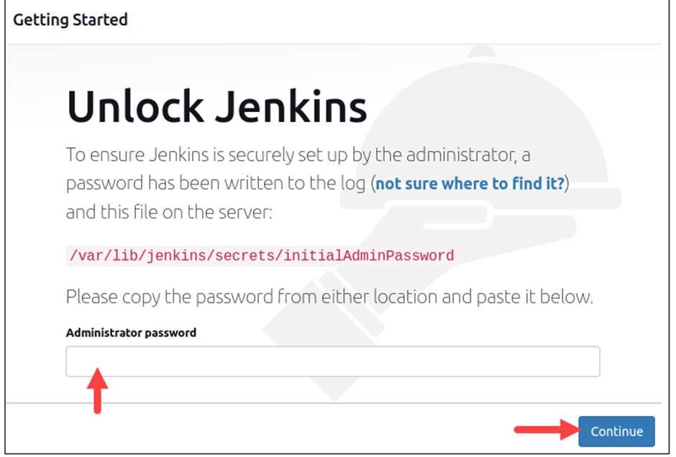
..

Slide 30
Jenkins Jobs
Jenkins jobs are a way to automate tasks and processes using the Jenkins automation server. A job is a specific task or set of tasks that Jenkins can execute automatically or on a schedule.
Freestyle jobs: These are the most basic type of job in Jenkins. They allow you to specify a set of build steps that Jenkins will execute when the job is triggered. You can also configure parameters, triggers, and post-build actions.
Pipeline jobs: Pipeline jobs allow you to define your entire build process as a series of stages, each of which can contain multiple steps. You can define your pipeline using a Jenkinsfile, which is a script that describes the stages and steps of your build process. Pipeline jobs are more powerful than freestyle jobs and provide better visibility into the entire build process.

Slide 31
..
Multi-configuration jobs: Multi-configuration jobs allow you to run the same build process on multiple platforms or environments. You can define multiple configurations and specify different parameters or build steps for each configuration.
Maven jobs: Maven jobs are designed specifically for building Maven projects. They allow you to specify a Maven POM file, which contains the build configuration for your project. Jenkins will automatically download the required dependencies and build your project according to the configuration in the POM file.
External jobs: External jobs allow you to integrate with other build systems or tools, such as Gradle or Ant. You can define the build steps using a script or configuration file, and Jenkins will execute the steps as an external process.

Slide 32
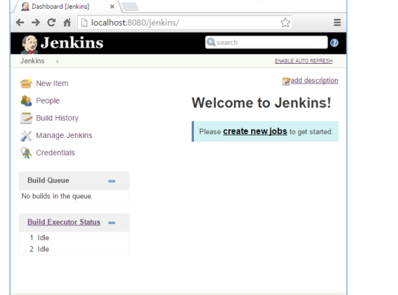
Creating first Jenkins freestyle job
From the Jenkins Dashboard, click on the New Item link present on the left side. This is the link to create a new Jenkins job.

Slide 33
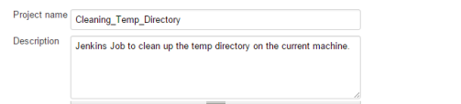
..
Name your Jenkins job Cleaning_Temp_Directory in the Item name field.
Select the Freestyle project option that is present right below the Item name field.
Click on the OK button to create the Jenkins job
You will be automatically redirected to the page where you can configure your Jenkins job
Below that, we have the option to add some description about our Jenkins job. I added one for our Jenkins job

Slide 34
Manage Jenkins
Manage Jenkins is a section in the Jenkins web interface that provides access to various administrative tasks and configuration options. Here are some of the key features of the Manage Jenkins section:
Global configuration: The Global Configuration page allows you to configure Jenkins settings that apply to the entire installation, such as security settings, email notifications, and plugin management.
User management: The User Management page allows you to manage Jenkins user accounts and permissions. You can create new user accounts, modify existing accounts, and assign permissions to specific users or groups.
Plugin management: The Plugin Manager page allows you to install, update, and remove Jenkins plugins. Jenkins has a vast library of plugins that can extend its functionality and integrate with other tools and systems.

Slide 35
..
System information: The System Information page provides detailed information about the Jenkins installation, including system properties, environment variables, and installed plugins.
Script Console: The Script Console allows you to run Groovy scripts directly on the Jenkins server. This can be useful for performing administrative tasks, troubleshooting issues, or automating tasks.
Manage Nodes: The Manage Nodes page allows you to manage the nodes or agents that Jenkins uses to execute build jobs. You can add new nodes, remove existing nodes, and configure node-specific settings.
Manage Credentials: The Manage Credentials page allows you to manage credentials that are used by Jenkins, such as passwords and SSH keys. You can create new credentials, modify existing credentials, and manage credential domains.

Slide 36
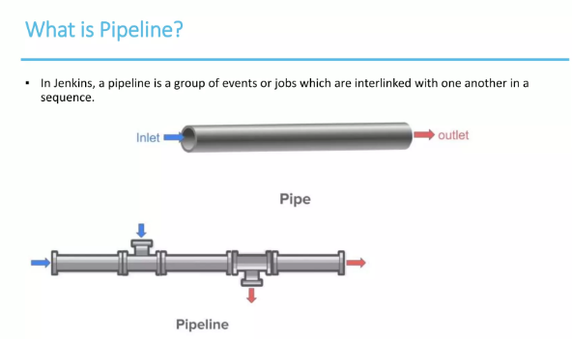
What is pipeline?

Slide 37
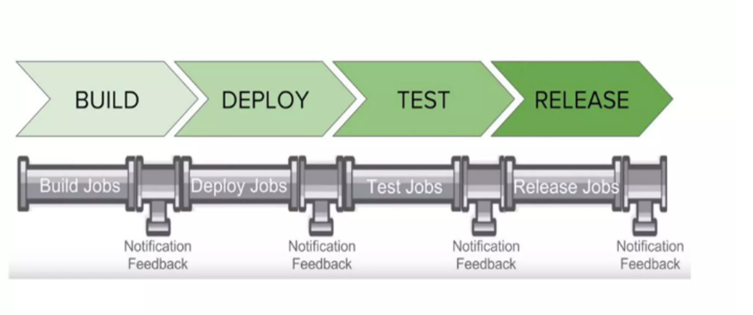
..

Slide 38
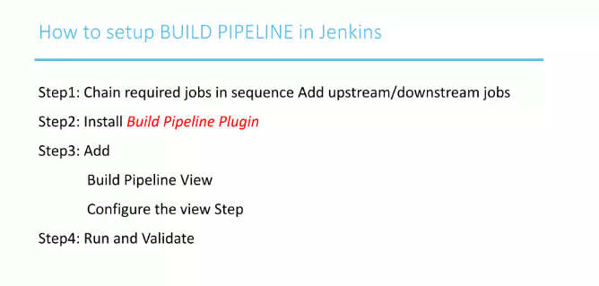
Install pipeline plugin

